Slide 1

AMAZON FRESH ANALYSIS
PRESENTED BY
SATHYANARRAYANAN

Slide 2

OBJECTIVE
To design a relational database for Amazon Fresh that organizes this data efficiently, allows for meaningful analysis, and supports critical business decisions
Key Deliverables:
Customer Insights
Product Management
Supplier Analysis
Revenue Analysis
Customer Satisfaction

Slide 3
SQL IMPLEMENTATION SUMMARY
Data Loading
All datasets (Customers, Products, Orders, etc.) were imported directly from Excel files provided in the project repository.
SQL Syntax Usage
SQL commands and syntax were used throughout each analysis slide.
Queries cover DDL, DML, JOINS, AGGREGATIONS, SUBQUERIES, and CONSTRAINTS.
Key SQL Concepts Applied
DDL: Table creation with constraints (e.g., CHECK, DEFAULT, PRIMARY KEY).
DML: INSERT, UPDATE, and DELETE used during sample operations.
JOINS: Used to link tables like Orders, Order_Details, and Customers.
Subqueries: Applied for tasks like identifying top revenue products and inactive customers.

Slide 4
SQL IMPLEMENTATION SUMMARY
Key SQL Concepts Applied
Aggregations: For revenue totals, product rankings, and customer spending.
Constraints: Applied NOT NULL, CHECK, DEFAULT, and UNIQUE constraints as per requirements.
Primary & Foreign Keys:
Defined PRIMARY KEY for identity columns like CustomerID, ProductID, etc.
Established FOREIGN KEY relationships to maintain data integrity (e.g., Orders.CustomerID references Customers.CustomerID).

Slide 5
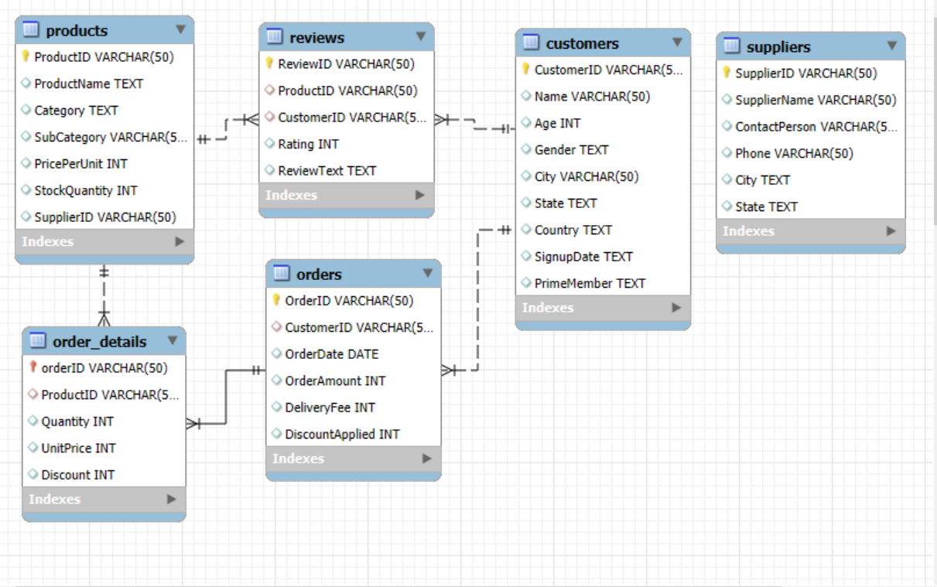
ER DIAGRAM

Slide 6
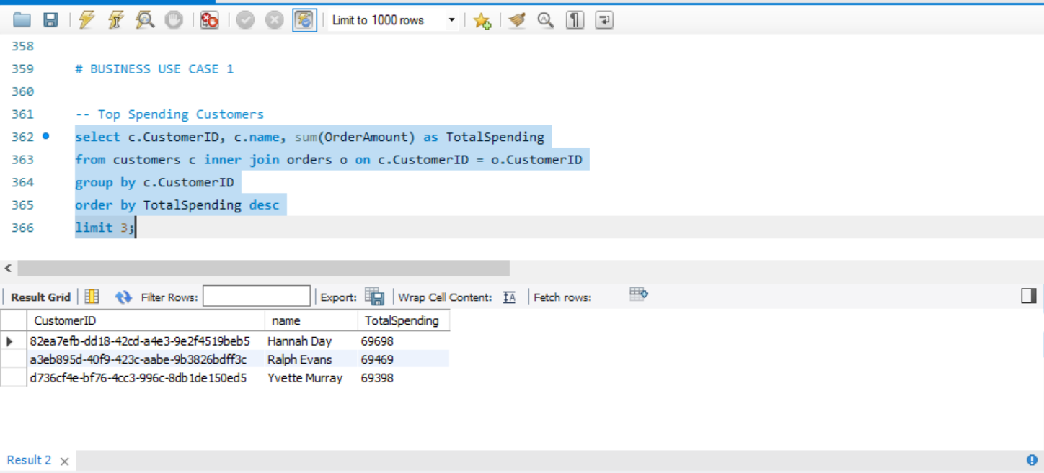
CUSTOMER INSIGHT
TOP SPENDING CUSTOMER

Slide 7
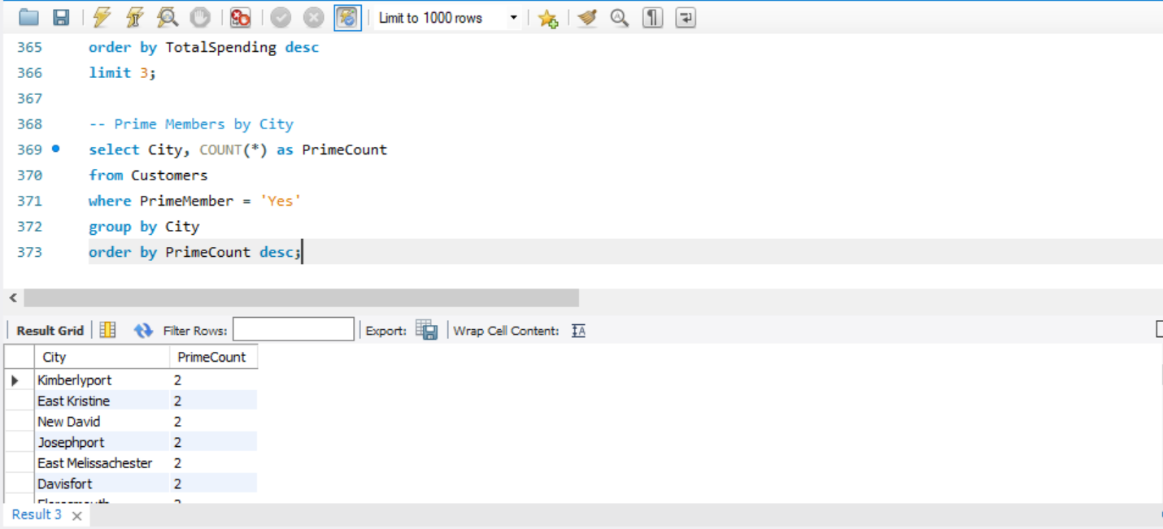
CUSTOMER INSIGHT
PRIME MEMBERS BY CITY
Out of the total cities, we have two Prime member each from 17 cities, and 471 cities have only one Prime member each.

Slide 8
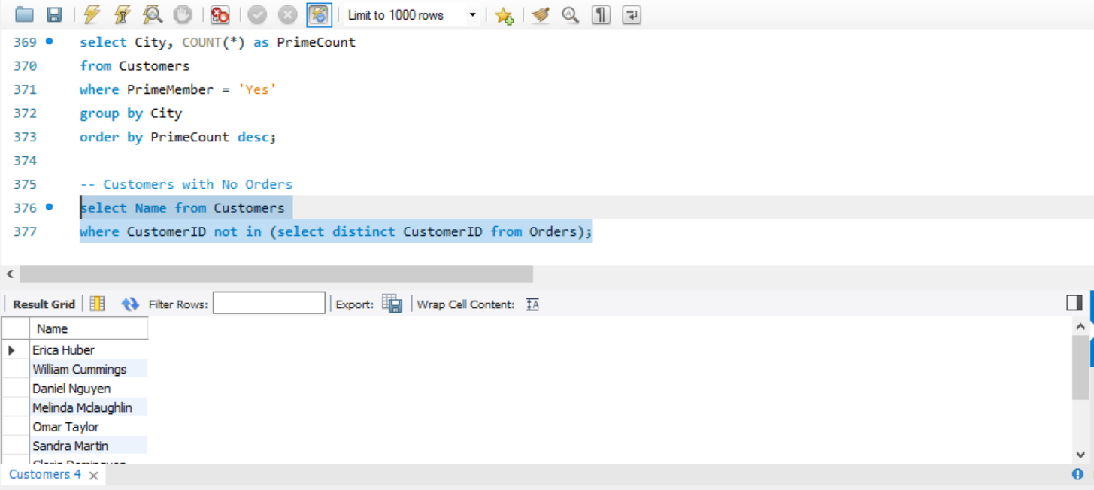
CUSTOMER INSIGHT
CUSTOMER WHO HAVEN’T PLACED ANY ORDER
We can see that there are a total of 11 members who didn’t place any orders.
Out of the total cities, we have one Prime member each from 17 cities, and 471 cities have only one Prime member each.

Slide 9
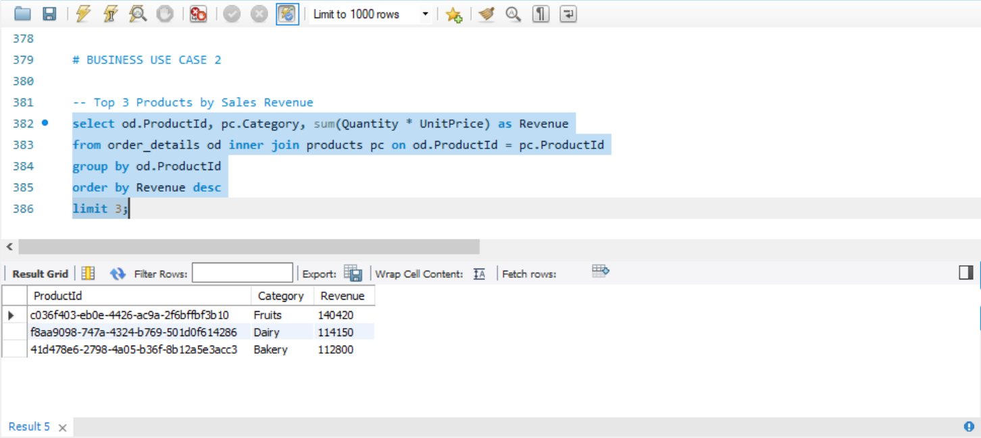
PRODUCT ANALYSIS
TOP 3 CATEGORY BY SALES REVENUE

Slide 10
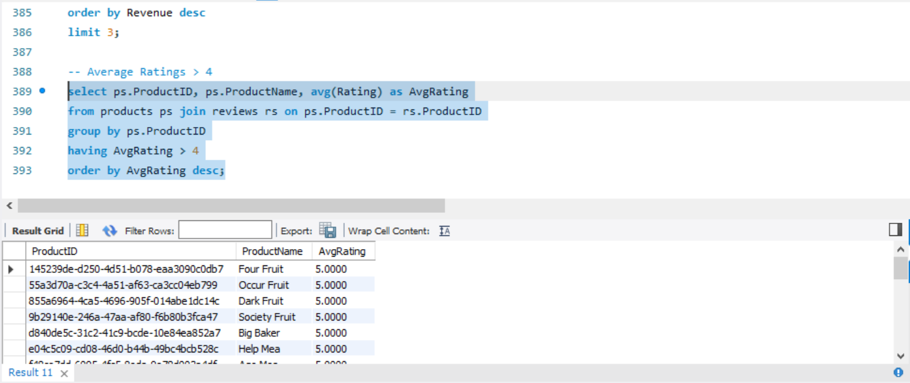
PRODUCT ANALYSIS
PRODUCT WITH AVERAGE RATING > 4

Slide 11
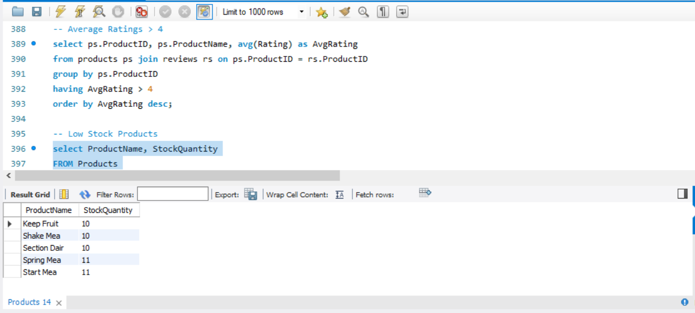
PRODUCT ANALYSIS
LOW STOCK PRODUCTS

Slide 12
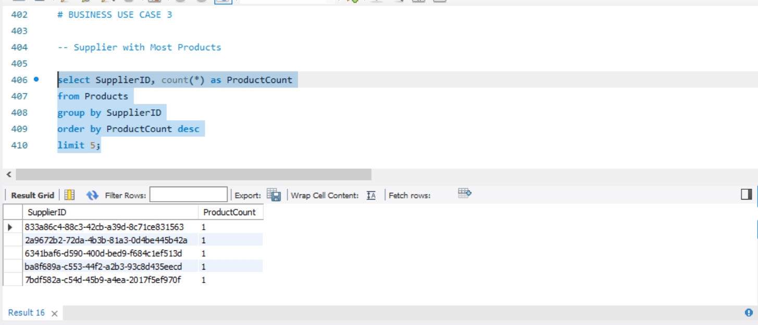
SUPPLIER ANALYSIS
SUPPLIER WITH MOST PRODUCTS

Slide 13
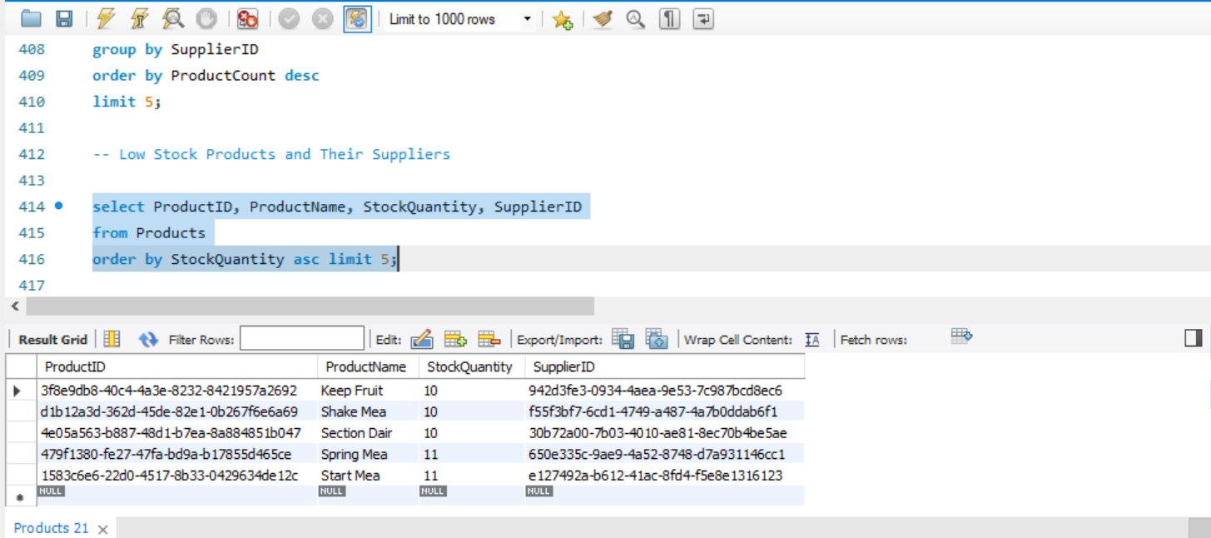
SUPPLIER ANALYSIS
LOW STOCK PRODUCT AND THEIR SUPPLIERS

Slide 14
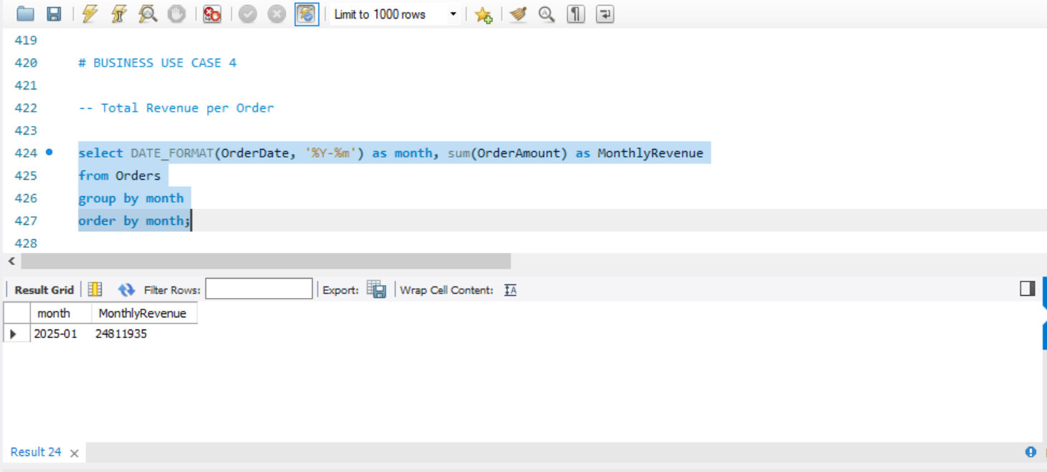
REVENUE ANALYSIS
TOTAL REVENUE

Slide 15
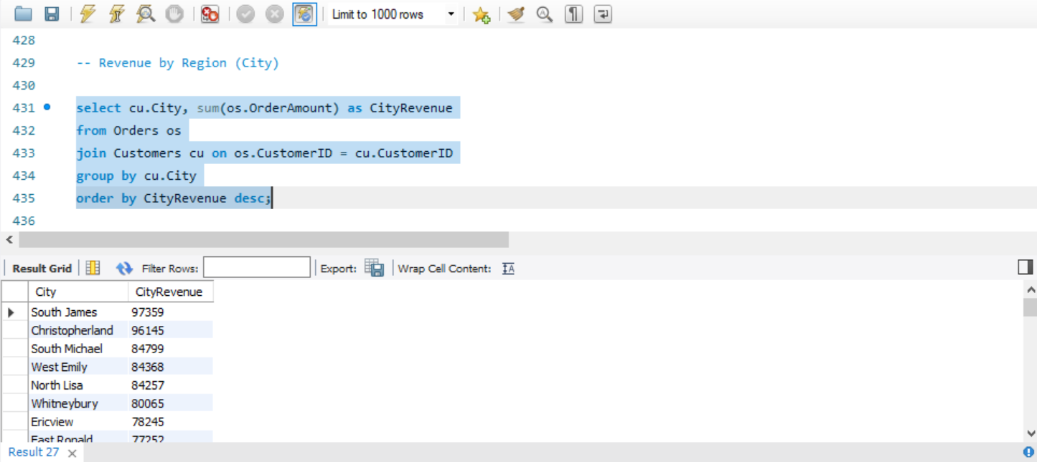
REVENUE ANALYSIS
REVENUE BY REGION (CITY)

Slide 16
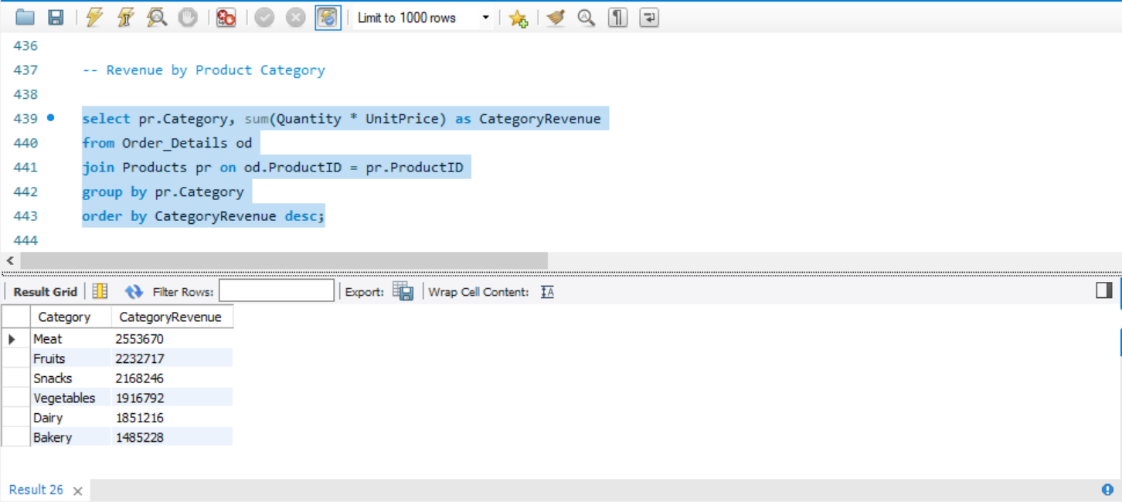
REVENUE ANALYSIS
TOP PRODUCT CATEGORY BY REVENUE

Slide 17
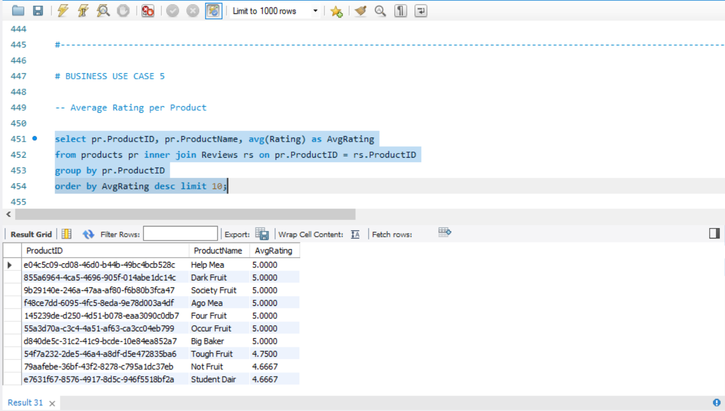
CUSTOMER SATISFACTION
TOP 10 PRODUCTS WITH HIGHEST AVERAGE RATINGS

Slide 18
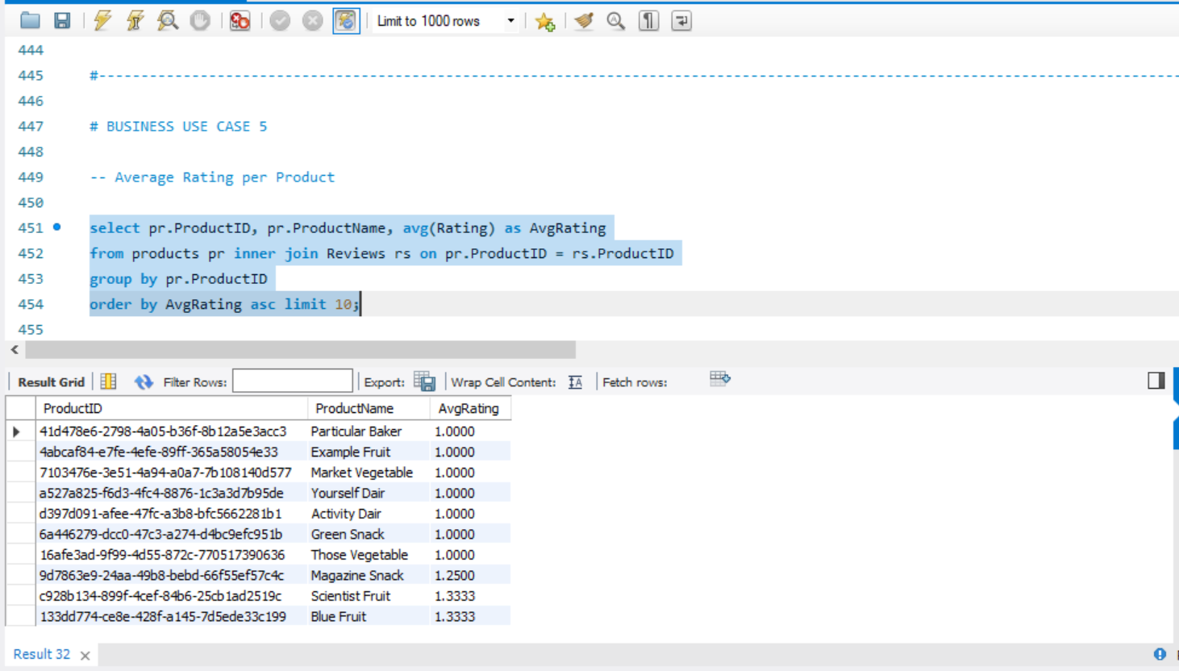
CUSTOMER SATISFACTION
BOTTOM 10 PRODUCTS WITH LOWEST AVERAGE RATINGS

Slide 19
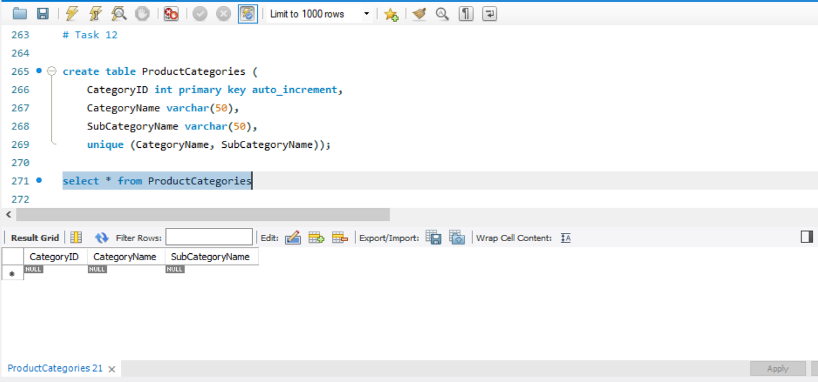
NORMALIZATION

Slide 20
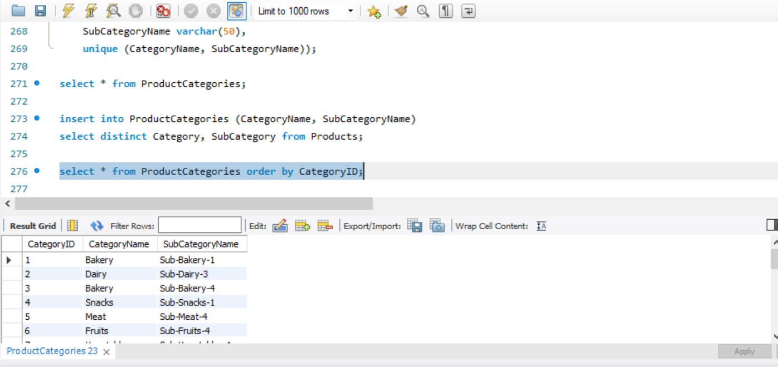
NORMALIZATION

Slide 21
BUSINESS RECOMMENDATIONS
Restock Top-Revenue Products Immediately - Prioritize inventory replenishment for these high-performing products to prevent stockouts and revenue loss.
Promote High-Rated Products (>4 Stars) in Marketing Campaigns - Feature these products in emails, homepage banners, and Prime deals to leverage customer trust.
Resolve Low-Stock Issues with Priority Suppliers - Collaborate with suppliers of these products to expedite restocking or diversify sourcing.
Target Prime Membership Drives in Cities with Low Adoption - Offer city-specific Prime trials or perks (e.g., free delivery) to convert frequent shoppers.
Re-Engage Inactive Prime Customers - Send personalized reactivation offers (e.g., "$10 off next order").
Optimize Assortment in Top-Revenue Cities - Analyze top cities’ buying trends and expand inventory of locally popular categories.

Slide 22
BUSINESS RECOMMENDATIONS
Negotiate with High-Volume Suppliers - Bulk-discount agreements or exclusivity deals to reduce costs for high-supply products.
Bundle Top-Rated Products with Complementary Items - Create pre-packaged bundles (e.g., pasta + sauce) to increase average order value.
Incentivize Reviews for New Products - Offer loyalty points for reviews to gather feedback and improve SEO rankings.
Audit Underperforming Product Categories - Discontinue or discount stagnant categories to free up warehouse space.

